Slide 1
Week 8
Assignment：Vertex Cover Problem
Name：张颜兵
Id：12132428
Department：MAE
SuperVisor：Prof.吴雷
Research Topic：Engineering calculation

Slide 2
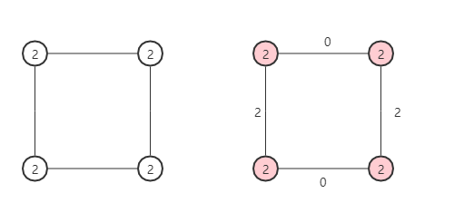
E1
$Optimal w\left(C^{∗}\right)=4，w\left(Pricing Method\right)$=2* $w\left(C^{∗}\right)$=8

Slide 3
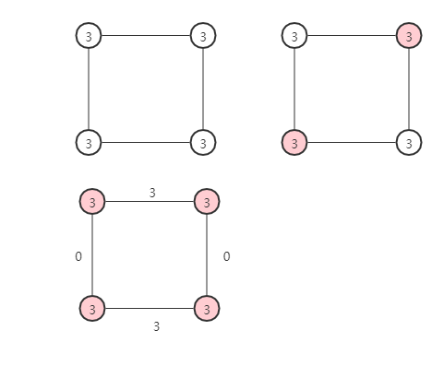


E2
$$Greedy Solution S_{g}$$
$$Pricing Method S_{p}$$
$$Optimal w\left(C^{∗}\right)=6=w\left(S_{g}\right)，w\left(S_{p}\right)=2∗w\left(C^{∗}\right)=9$$

Slide 4
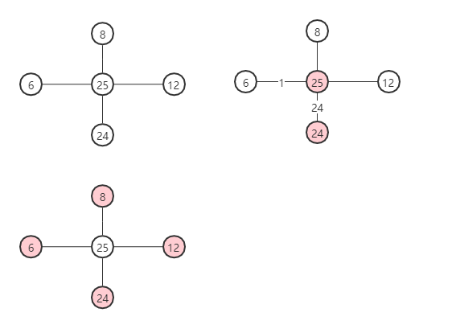


E3
$$Pricing Method S_{p}：worst case$$
$$Greedy Solution S_{g}$$
$$Optimal w\left(C^{∗}\right)=25,w\left(Pricing Method\right)≤w\left(S_{p}\right)=49<w\left(S_{g}\right)=50\}$$

